Slide 1


SAP UI5 & FIORI with OData TRAINING using BAS
Anubhav Oberoy
Day – 11

Slide 2

Agenda – Day 11
Use Case 2 – Dynamic Fragment
What is OData?
oData Basics.
Structure of Odata.
Client Side Query With Odata.
Get Operations.

Slide 3
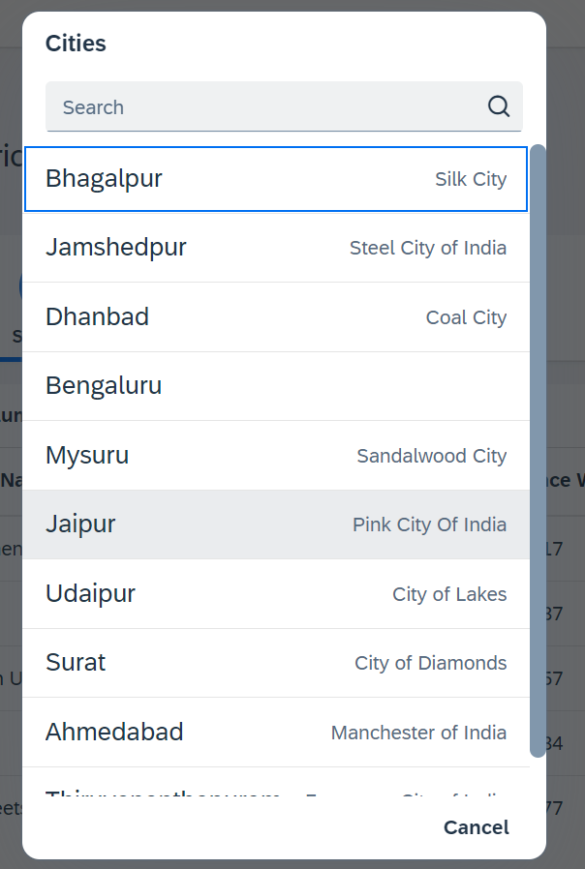
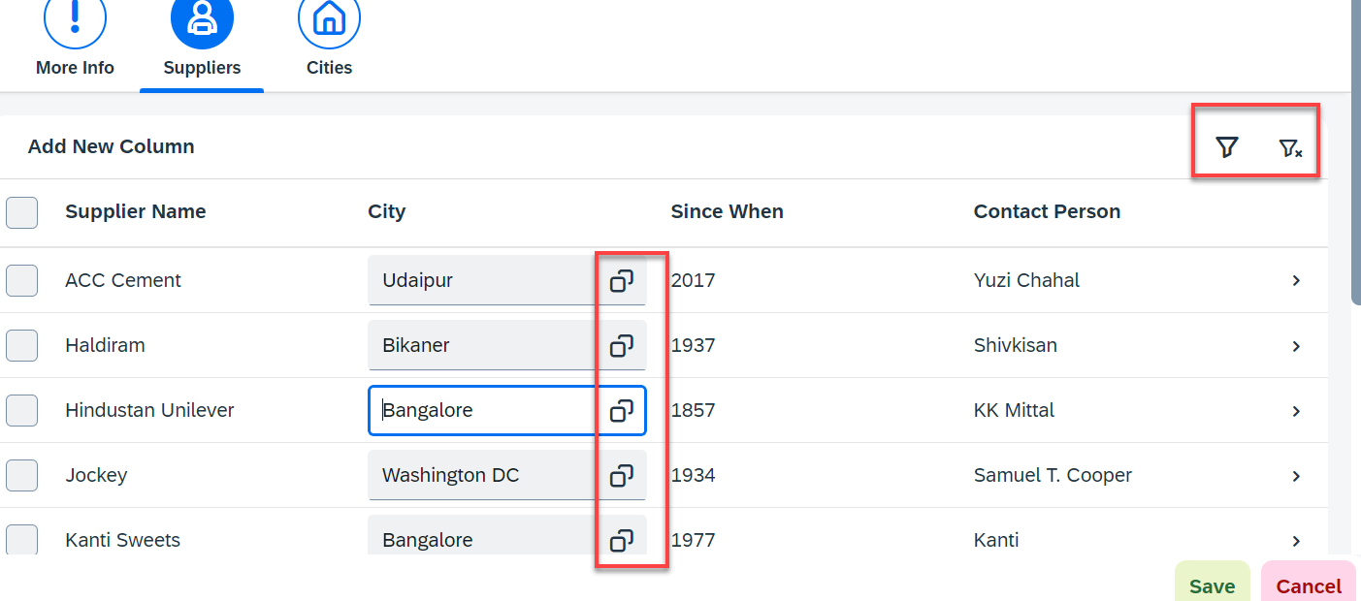
Hands – on: Fragment Use Case 2 (Using JS Code)
My manager asked me to develop following requirements
Add a filter button in the toolbar of the table, and when we click filter icon, it should load a popup with all the list of suppliers. When we select supplier inside filter it should filter data in the table.
Inside the table we have a city field. We would like to enable a value help (F4 Help), when we click on same, it should open a popup which shows all the list of cities on screen.
Part 1: Opening filter popup using the Filter Button.
popup.fragment.xml
supplierTab.fragment.xml
View2.controller.js
Part 2: Opening the Value help popup in the Supplier Table
popup.fragment.xml
supplierTab.fragment.xml
View2.controller.js

Slide 4



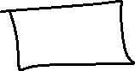


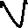





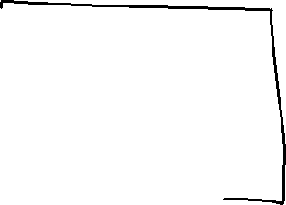

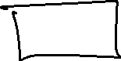


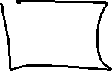

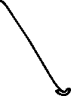
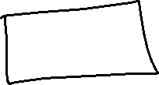

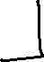
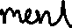

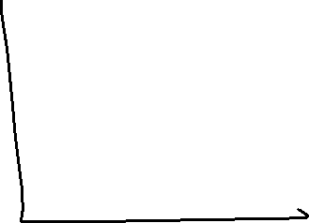

Slide 5





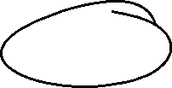
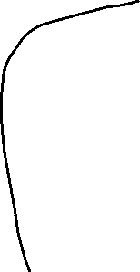








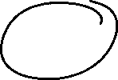

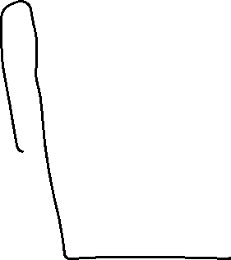
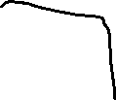


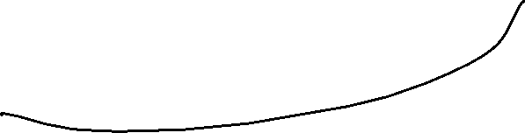

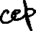


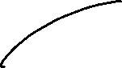

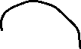



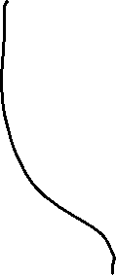



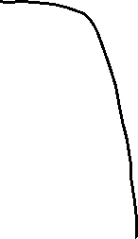


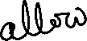

Slide 6
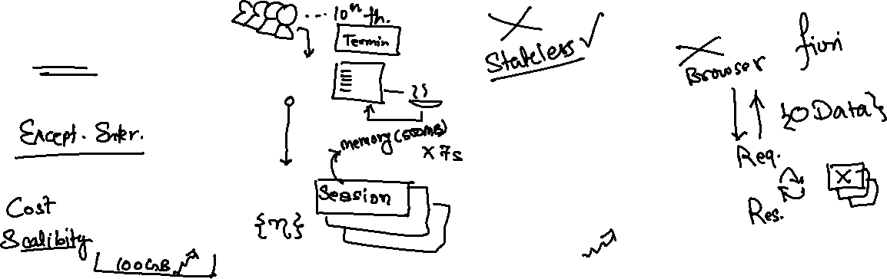
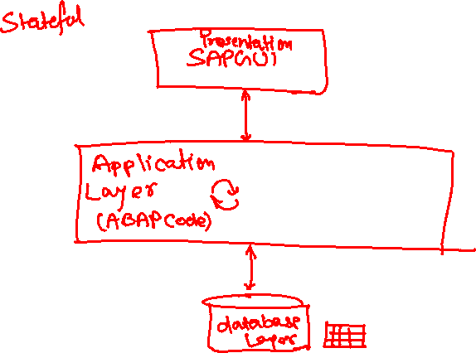
What is OData?
OData Stands for Open Data Protocol, It is an stateless protocol; it is an OASIS standard to communicate to server using REST(Represerntational state Transfer) based service. It was acquired by Microsoft in 2012 and adopted by many companies to build REST services to expose data over internet HTTP/HTTPs protocol.
Funda Fox
Fiori cannot talk to FM, program, CDS views, …. Fiori only and only talk to OData service which is built on top of FM, ABAP code, CDS view.

Slide 7
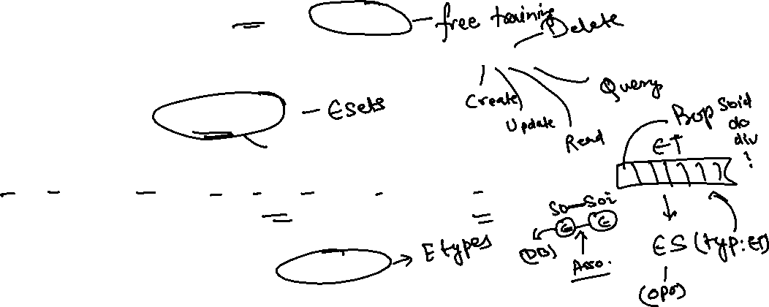
OData Basics
This OData Protocol is mainly used to expose data over HTTP. It does not matter from consumer point, which technology the OData is built on. This way we are abstracted from the underlaying programming/database. Fiori only and only understand OData, it cannot talk to BAPI, BADI, FM, CDS View, Interface, Class.
Lets start understanding a sample odata given by Microsoft on odata.org
1. Service document – is a collection of entity sets to access the data.
An Entity set is built by an Entity Type. Entity Set is the right end point to perform CURDQ operations
Entity Type describes the structure of the data – metadata
https://services.odata.org/V3/Northwind/Northwind.svc/
2. Service metadata document – describes all the properties and entity types
Which includes key, properties, attributes (nullable, key, max length, create), NavigationProperty
Also includes the relations between entities called association (compare with Foreign key)
Usually one database table is considered as one entity.
https://services.odata.org/V3/Northwind/Northwind.svc/$metadata
https://chrome.google.com/webstore/detail/jsonview/chklaanhfefbnpoihckbnefhakgolnmc
https://chrome.google.com/webstore/detail/xml-tree/gbammbheopgpmaagmckhpjbfgdfkpadb

Slide 8

Structure of an OData URL
http://stcfin.st.com:8021/sap/opu/odata/IWBEP/GWSAMPLE_BASIC/ProductSet?$format=json
http(s)://hostname:port/sap/opu/odata/sap/SERVICENAME_SRV/ENTITYSET?p1=val&p2=val
Protocol
Address & Port
Path prefix
Service Name
End Point Access Data
Query Options

Slide 9






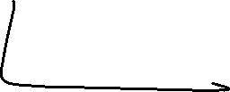

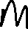
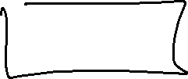


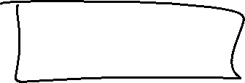
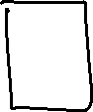

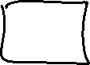


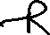
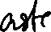


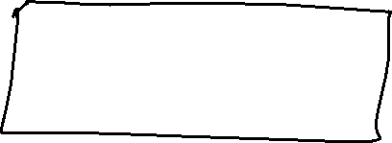
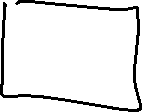





Slide 10
Client Side Query with OData
Sets the page size of results.
02
$top
Indexes into a result set. Also used by some APIs to implement paging and can be used together with $top to manually page results.
Returns the results in the specified media format.
01
03
$format
$skip
ODATA Query
06
04
Retrieves related resources.
Filters properties (columns).
$expand
$select
05
$filter
Filters results (rows).

Slide 11


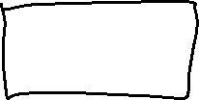


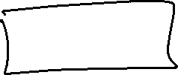
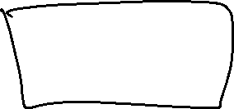

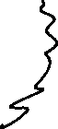

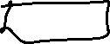
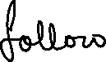
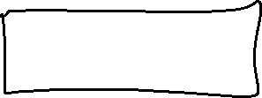





Slide 12
GET operations
Read All the data from Products (SELECT * FROM dbtab)
https://services.odata.org/V3/Northwind/Northwind.svc/Products?$format=json
Read few properties of entity (SELECT col1, col2 FROM dbtab)
https://services.odata.org/V3/Northwind/Northwind.svc/Products?$format=json&$select=ProductID,SupplierID
Read Top Records (Pagination SELECT * UP TO ROWS n ..)
https://services.odata.org/V3/Northwind/Northwind.svc/Products?$format=json&$top=3&$skip=10
Read data by filtering (SELECT * FROM dbtab WHERE condition)
https://services.odata.org/V3/Northwind/Northwind.svc/Products?$format=json&$filter=SupplierID%20eq%203
SELECT * FROM dbtab WHERE col LIKE ‘%pattern%’
https://services.odata.org/V3/Northwind/Northwind.svc/Products?$format=json&$filter=substringof(%27Cola%27,ProductName)%20eq%20true
Reading count of the records (SELECT COUNT(*) FROM dbtab)
https://services.odata.org/V3/Northwind/Northwind.svc/Products/$count
Reading Single record by its key (SELECT SINGLE * FROM edbtab WHERE pkey = ‘key’)
https://services.odata.org/V3/Northwind/Northwind.svc/Products(11)?$format=json
Join and read data together (SELECT * FROM tab1 INNER JOIN tab2 ON cond)
https://services.odata.org/V3/Northwind/Northwind.svc/Products(11)?$format=json&$expand=Supplier,Category
Association : It’s the relation between multiple Data , it is similar as foreign key relation in DB world
When we create association system will create the navigation property which we can use as a pointer to load the dependent data.

Slide 13
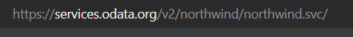
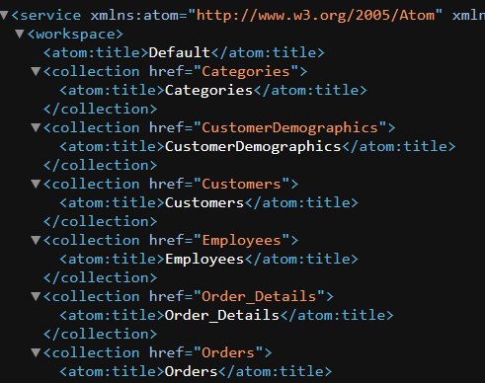
Hands-on : Get Operations
Practice all the get operations in the previous slide by your own on the northwind service url.
Links were given in the previous slide.

Slide 14

End of Day 11

Slide 15

Questions

Slide 16

Anubhav Oberoy

Slide 17


We’re committed to empower you to be
Most Desirable Resource
through powerful training solutions.
We build the workforce of the future.
250+
Corporate Clients
30,000+
Learners Trained
25000+
Learners Placed
FREE WEBINARS
Sign up for free webinars with industry experts every fortnight!
Enroll Now!
Contact us today!
https://anubhavtrainings.com/

Slide 18




More from AnubhavTrainings.com

Slide 19
Title
Content

